Slide 1
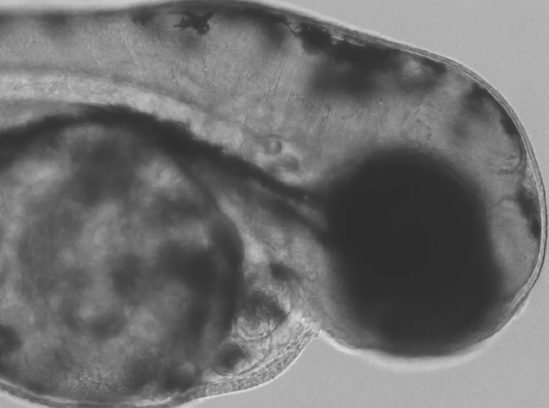
Heart Rate of Zebrafish Analysis
University of Utah
Biomedical Engineering Department
Arianna LaLonde, Brendan Oler, Zakary Wankier

Slide 2
Objectives

Slide 3
Importance of the Program

Slide 4


Data Loading
Program called as function
Video name as input, string
videoReader and videoPlayer objects created

Slide 5
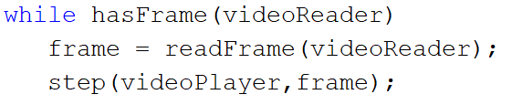
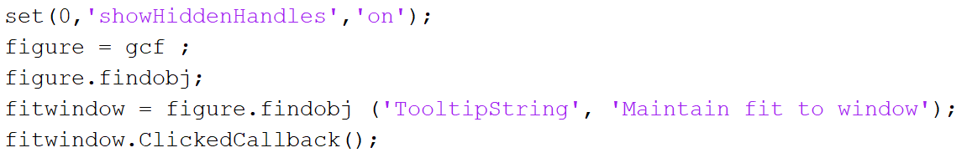
Data Visualization
Steps through each frame in while loop
Duration of the videoReader object
Uses videoPlayer to display video
Uses figure object to fit video to window size

Slide 6
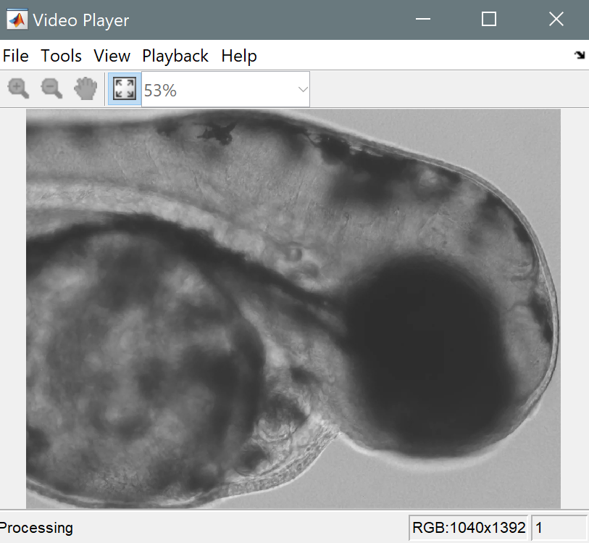
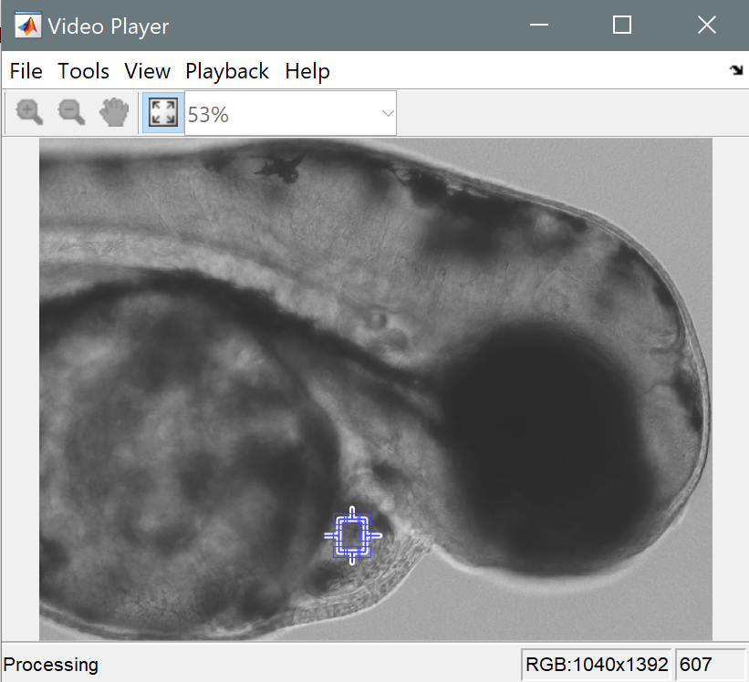
Data Visualization

